Slide 1
Business Case : Insurance
EXL Excellence Quotient 2016

Slide 2
Background:
Home insurance business of XYZ Insurance is observing a steep decline in the number of new customers/new policies they are writing. Currently, majority of the customers buy policies through their website: The customer submits a policy application (with the required details) and receives a price. He/she has the option of purchasing the policy at the quoted price or rejecting the quote
The likelihood of a customer to buy a policy at the received quote can be analyzed on various characteristics including behavioral attributes, demographics, property risk profile etc. With the steep decline in market share , XYZ’s Marketing Department is entrusted with the task of analyzing historical quote data in an attempt to understand drivers of policy quote conversion and recommend changes to the overall process of identifying ‘good’ prospective customers
Task:
Perform segmentation analysis to analyze who are most likely to purchase a policy and Develop a statistical model to predict the probability of a customer to purchase a policy from XYZ Insurance and to understand the drivers of Quote Conversion and specifically recommend changes in company’s strategy
Data:
Three years of customer quote data containing variables related to
1. Customer Demographic/Risk attributes
2. Property information and risk data

Slide 3
The variables given in the data were mostly numerical, a few variables like Agency Name were character. Those numerical variables which were taking less than or equal to 7 unique values, we converted them to categorical for modelling and visualization purposes. Variables which were character were also used as categorical variable in analysis. We also used the variable Quote Date by extracting month out of it to capture seasonality.
Our Analysis Procedure can be summarized as follows:
Step1: Univariate Analysis
This was done for the purpose of understanding the data and its distribution.
Step2: Analysis wrt Target Variable
This yielded several variables which were discriminative between conversion and non-conversion cases like
Premium Amount, Property Age etc.,
Step3: Multivariate Analysis
Analysis of two or more variables together with respect to target population. Multivariate Plots became complex however
some of the variables which were adjudged non-discriminative by bivariate analysis became important on combination with
others.
Step4: Segmentation Analysis
Combination of Unsupervised Machine Learning Techniques and insights from bivariate and multivariate analysis helped
segment the consumers which should be targeted
Step4: Modelling
Step5: Model Analysis
Step5: Results Analysis
Step6: Misclassification Reasons Analysis
All the Visualizations are summarized in subsequent slides.

Slide 4
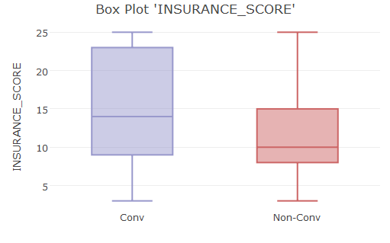
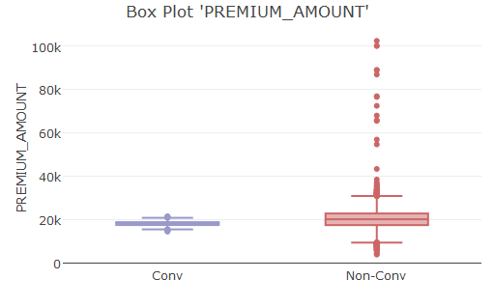
BIVARIATE ANALYSIS
Box Plots of Continuous Predictors with respect to target variable tells us Insurance Score and Premium Amount were were discriminative between conversion and non conversion cases. When Premium Amount is high Consumers tend to reject the policy while same is also true for policies of very low premium.
DISCRIMINATIVE PREDICTORS
LESS OVERLAPPED
BOXES

Slide 5
Moving on to categorical predictors, Variables like Number of Safety Devices and Property Age and had significantly different conversion rate in different levels. Consumers with higher property age were less likely to buy policies.
DISCRIMINATIVE PREDICTORS
VARYING QUOTE CONVERSION RATES IN DIFFERENT BINS

Slide 6
Agency B and Agency D were more likely to influence customers while Agency E though attracted most customers its conversion rate was very low. People of State “CA” and “NJ” were more likely to buy policies.
DISCRIMINATIVE PREDICTORS
VARYING QUOTE CONVERSION RATES IN DIFFERENT BINS

Slide 7
An important factor was whether the property was under construction. Customers whose property where under construction never bought policies. People of Coastal Areas were also less likely to buy policies
DISCRIMINATIVE PREDICTORS
VARYING QUOTE CONVERSION RATES IN DIFFERENT BINS

Slide 8
Customers who had smoke alarms had significantly higher rate of quote conversion that than without alarms. Also those who had prior claims were very unlikely to buy policy again which might be due to dis satisfaction from company’s service
DISCRIMINATIVE PREDICTORS
VARYING QUOTE CONVERSION RATES IN DIFFERENT BINS

Slide 9
Dwellers of high catastrophic risk zone refrain from buying policies and understandably so as many policies either do not cover castastrophical damage or if they do they tend to be costly. Customers with higher coverage bin values are more likely to buy
DISCRIMINATIVE PREDICTORS
VARYING QUOTE CONVERSION RATES IN DIFFERENT BINS

Slide 10
While some of the predictors were discriminative between conversion and non conversion cases, some of the factors were unable to differentiate between the two like : number of family members and whether the customer has pets
IMPARTIAL PREDICTORS
ALMOST SAME COVERSION RATE IN DIFFERENT LEVELS

Slide 11
We tried to consider two predictors at a time and see how they combine to differentiate between conversion and non conversion cases. Combinations became better differentiators that the individual predictors themselves. We tried several combinations. Some of those whose bins were significantly different in terms of conversion rate have been shown here
MULTIVARIATE ANALYSIS
We can see that the combination of property age and number of safety devices yield conversion rates of as high as 0.45 in some bins, which is much better than their both of them taken individually

Slide 12
We can see that the combination of agency name and insurance score devices yield conversion rates of as high as 0.48 in some bins, which is much better than their both of them taken individually

Slide 13
The Quote conversion rate is significantly different across different bins formed by combination of Smoke Alarm and Coastal area and goes as high as 0.41 in one of the bins

Slide 14
We can see that the combination of agency name and state yield conversion rates of 0.45 in one of the bins. This analysis was also performed to see if any particular agency has a dominance in a particular state. This plot could not suggest any clear dominance. Everywhere D was most dominant and E was least

Slide 15
Analysis of original roof indicator together with property age indicates that If the property even after being 4 years old doesn’t have a renewed roof, it will have very low conversion rate while for newer properties it doesn’t really make a difference whether or not roof has been renewed or not

Slide 16
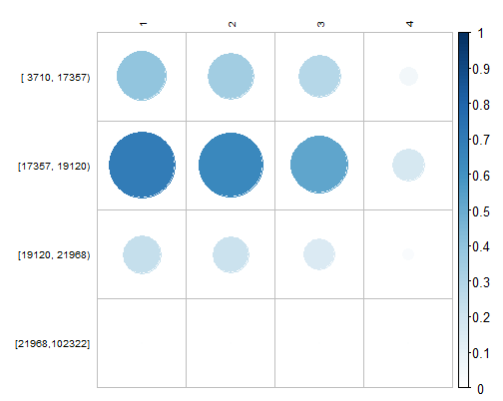
Property Age
Here also the conversion rate is significantly different across different bins formed by combination of Property Age and Premium Amount
Premium Amount
Conversion Rate in different levels of combination of Property Age and Premium Amount

Slide 17
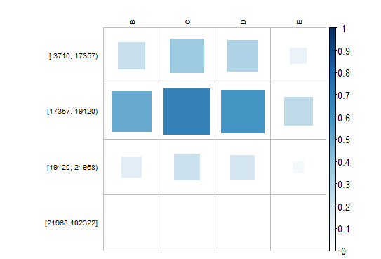
Agency Name
Conversion Rate of Agency C when the premium amount is between 17k to 19k is nearly 1
Premium Amount
Conversion Rate in different levels of combination of Property Age and Premium Amount

Slide 18
SEGMENTATION ANALYSIS
Segmentation Analysis was performed in multiple stages. It was made sure that our segments cover the entire data points. Initially we used a popular clustering technique named k means clustering, which assigns clusters based on the distances from the cluster centroid. The results were fruitful and in this stage we were able to segment out the quotes which were almost completely unlikely to be converted. We call Cluster 1 our “Segment1”
 | CLUSTER 1 | CLUSTER2
Non-Conversion | 15919 | 12496
Conversion | 6581 | 24
Total | 22500 | 12520
CLUSTER CENTROID OF SOME VARIABLES
 | PREMIUM AMOUNT | PROPERTY AGE | SMOKE ALARM | SAFETY DEVICES | PRIOR CLAIM | COASTAL AREA | UNDER CONSTRUCT | DEADBOLT LOCKS | INSURANCE SCORE
Cluster1 | 17443 | 2.79 | 0.36 | 1.02 | 0.16 | 0.25 | 0.03 | 0.29 | 13.12
Cluster2 | 23582 | 3.17 | 0.26 | 0.83 | 0.22 | 0.30 | 0.05 | 0.22 | 12.30

Slide 19
Stage 2 of the Segmentation Analysis involved further segmentation of Cluster 2 obtained by k means clustering. In cluster 2, quotes with Property Age = 4 were 90% likely to rejected. We call quotes in cluster 2 with property age =4 our “Segment2”. Deep diving further into remaining quotes, we see that when premium amount is less than 16000 quotes tend to be rejected the quote more than 92% of time, we call this segment our “Segment3”. At this point of time, in our remaining 9396 quotes we have more than 58% conversion rate
 | [1-3] | 4
Non-Conv | 5501 | 10418
Conv | 5533 | 1048
Total | 11034 | 11466
 | < 16k | > 16k
Non-Conv | 1516 | 3985
Conv | 122 | 5411
Total | 1638 | 9396

Slide 20
On rest of the population we created three more segments based on premium amount and coastal area. We tried further segmentation to increase conversion rate in the segment but no significant change was observed. Finally out of the 6 segments we had we merged two pairs having similar conversion cases to get 4 segments.
 | < 19k | > 19k
Non-Conv | 2379 | 1606
Conv | 4517 | 894
Total | 6896 | 2500
 | 0 | 1
Non-Conv | 1641 | 738
Conv | 4043 | 474
Total | 5684 | 1212

Slide 21
4 segments were formed out of the quotes. These segments had significant differences in conversion rates and all segments had sufficient population
 | Segment1 | Segment2 | Segment3 | Segment4 | Total
#Quotes | 12520 | 13104 | 3712 | 5684 | 35020
%Quotes | 35.7% | 37.4% | 10.6% | 16.2% | 100%
#Conv | 24 | 1170 | 1368 | 4043 | 6605
%Conv | 0.19% | 8.92% | 36.85% | 71.13% | 18.86%
Avg. Premium | 23582 | 16882 | 18983 | 17732 | 19638
Avg. Ins Score | 12.30 | 12.24 | 13.85 | 14.70 | 12.83

Slide 23
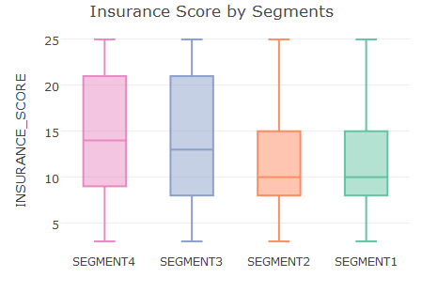
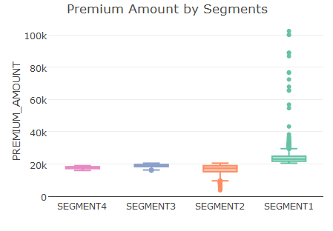
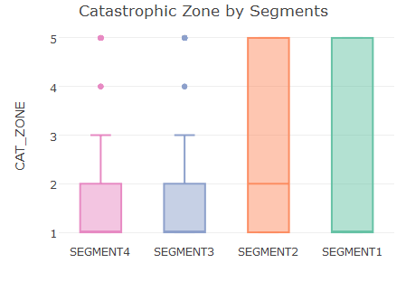
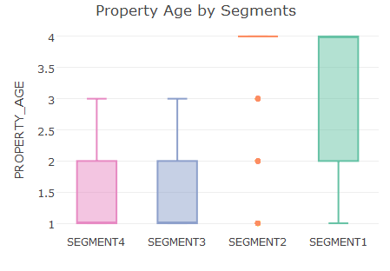
SEGMENT WISE BOXPLOTS OF SOME KEY VARIABLES

Slide 24
RECOMMENDED CHANGES IN COMPANY’S STRETEGY BASED ON SEGMENTATION ANALYSIS
By segmentation Analysis we can see that Quotes in Segment 1 and Segment 2 are seldom bought. While Quotes in Segment 4 are converted in more than 70% of the cases. Analysing the data in 4 segments, We could come up with some recommendations in company’s Strategy.
TARGET NEW PROPERTY HOLDERS :-Since the Customers whose Property Age is less than 4 i.e. the customers whose property are new are more prone to be convinced to buy policies, company should target new property owners. One way to do so would be to keep premium amounts low even if some customer does not have certain safety devices. Usually the new property owners might not have installed all the required safety devices like sprinkler system which might increase premium cost and quote might get rejected. Company can also introduce certain schemes to install essential safety devices in the property of the customer who shows interest in policy
IMPROVE RELATIONSHIPS WITH PAST CUSTOMERS :-While it is good to attract new customers, it is equally important to maintain healthy relationships with past customers. Some of the key factors that came up in the analysis suggest that company performs poorly when it comes to pleasing customers. Customers with prior claim bought policies only 2% of the time. The company needs to set up a team to analyze reason for the sense of dissatisfaction among the Customers. This might be the main reason for XYZ’s decline. Granted that as an insurance company XYZ may have to encounter some bad customers they should try and please them too for the sake of “word of mouth” or recommendation, which above all is a powerful driver for quote conversion

Slide 25
RECOMMENDED CHANGES IN COMPANY’S STRETEGY BASED ON SEGMENTATION ANALYSIS
CONTINUED…
INCREASE CONVERSION RATE OF AGENCY E :Since the Agency E attracts most customers but has the lowest quote conversion rate. Company should contact Agency E for reasons of the same and constitute a team to look into the matter. The Company can also provide some amount of discount in purchase of policy through Agency E. This is a potential area for improvement.
TARGET HIGH RISK ZONES : A large fraction of population (18462 out of 35020 i.e. more than 50%) resides in either catastrophic zone 5 or coastal areas. As expected the quote conversion rate in these areas is only 10% as the premium amount is higher (around 20k). This is another potential area of improvement for company XYZ. XYZ may create awareness about the possible catastrophic damage in these areas and convince people to buy policies that cover catastrophes like earthquake even when the premium amount is high for a better sense of security. This prospect might be risky but selective implementation can be very beneficial

Slide 26
SEASONALITY ANALYSIS
Since the variable Quote Date was given, we used it to perform seasonality analysis. Though the results did not indicate anything very useful but still it was worth noting that Conversion rates were higher by the end of the year (in months of Oct Nov and Dec) while it was lower in the beginning of the year (in months of Jan Feb and March
NOTE : X axis labels in the above plot are the year followed by week number of that year

Slide 27
MODELLING
In order to get better and more robust predictions about the chances of quotes being converted, we resorted to machine learning models. Machine learning models have the capability to combine multiple variables at a time which becomes cumbersome if done manually

Slide 28
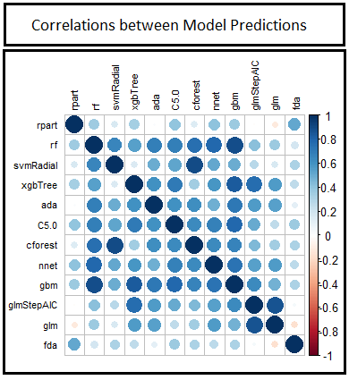
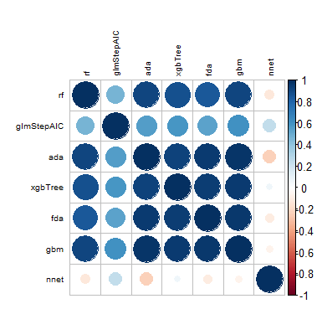
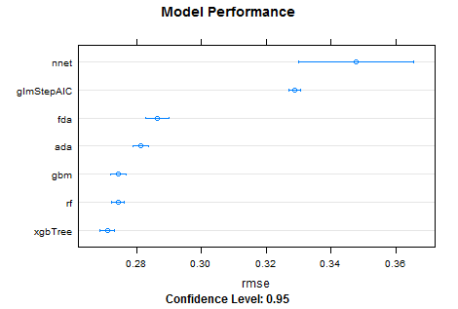
Several algorithms were used on the dataset after pre processing and rmse on the validation set was calculated each time. Linear models like logistic regression, linear SVM, xgboost linear performed poorly indicating that the problem is non-linear. However the liner model did help us spot good features. Tree based models like xgboost and random forest gave the smallest rmse.
MODELLING

Slide 29
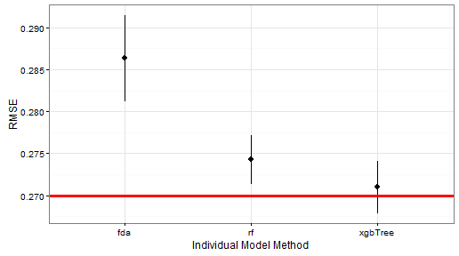
ENSEMBLE MODELS
To increase robustness of the model an ensemble was created using weighted average. Ensemble was indeed robust and had lower rmse than each of the models individually as can be seen in the plot below. Red Line shows rmse of Ensemble model

Slide 30
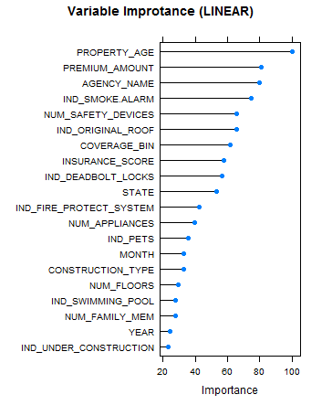
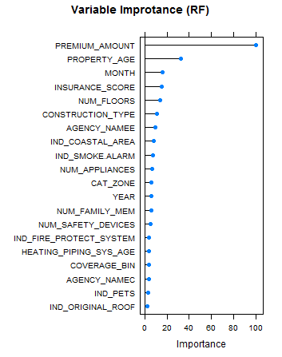
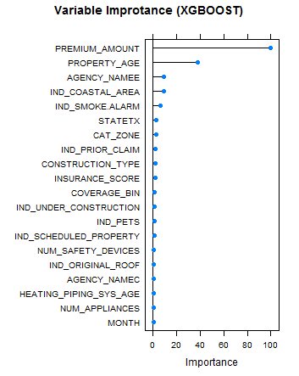
VARIABLE IMPORTANCE (MODELS)
Variable Importance according to linear , gradient boosted and forest models. These match with our initial bivariate and multivariate analysis.
Note : Month and Year were two variables extracted out of Date to capture seasonality

Slide 31
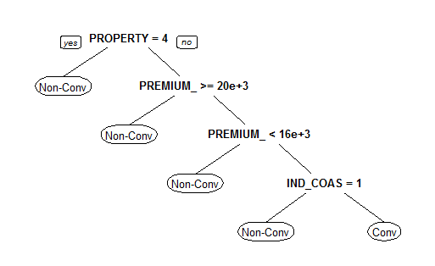
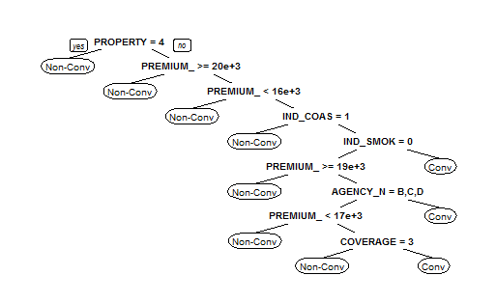
A very basic tree model makes its decision like shown below. This decision is consistent with our initial analysis.
VERY BASIC TREE
SLIGHTLY COMPLEX TREE
Note : Some Variable names were trimmed automatically like PROPERTY here refers to PROPERTY AGE and COVERAGE refers to coverage bins etc.

Slide 32
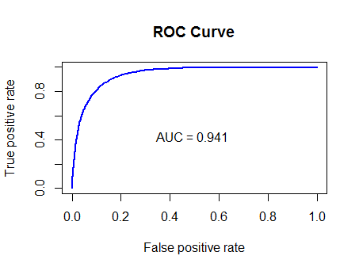
RESULTS ANALYSIS
On cross-validation set we achieved a maximum AUC of 0.941 and RMSE of 0.270. Adjusting the threshold we were able to obtain a sensitivity of 0.643 and a specificity of 0.953. In this case however we should be more concerned about Sensitivity as we do not want to leave out the quotes which are likely to be converted. Adjusting the threshold of prediction, we were able to come up with a sensitivity of 0.9 however accuracy reduced to 0.85 which is still very impressive
OBS/PRED | CONV | NON-CON
CONV | 1274 | 707
NON- CON | 398 | 8127
SENS = 0.643
SPEC = 0.953
ACC = 0.895
OBS/PRED | CONV | NON-CON
CONV | 1787 | 194
NON- CON | 1396 | 7129
SENS = 0.90
SPEC = 0.83
ACC = 0.85

Slide 33
JUSTIFYING MIS-CLASSIFICATION
We performed an analysis to justify reasons for misclassification. We found that the almost important features had similar conversion rate for False Negatives and True Negatives and hence the misclassification occurred. Plots below show that two important variables smoke alarm and coastal area had similar conversion rates in predicted negatives(FN & TN) as well as predicted positives(FP & TP) . In order to get better accuracy we need even better differentiators between conversion and non conversion cases
SIMILAR DISTRIBUTIONS FOR “TN AND FN” AS WELL AS “TP AND FP”

Slide 34
CONCLUSION
Through this Case Study, we were able to identify the key drivers of Quote Conversion and were able to develop a predictive model to predict the probability of a customer to purchase a policy from XYZ Insurance with almost 90% accuracy.
We also performed segmentation analysis to analyse which quotes are more likely to be converted and were able to identify two segments which were almost unlikely to be converted and one which had very high conversion rate.
Based on our analysis we were able to come up with recommended changes in strategy to increase the sales of XYZ Insurance.

